Slide 1
From epistemic background from World Health Organization Classification of Functioning, Disability and Health ICT to standards, protocols and indicators of disability as a transversal universal component of Inclusive Emergency Management
C. Kaiser, L. Brossard 2015

Slide 2
“Unless you try to do something beyond what you have already mastered, you will never grow.” ― Ralph Waldo Emerson

Slide 3
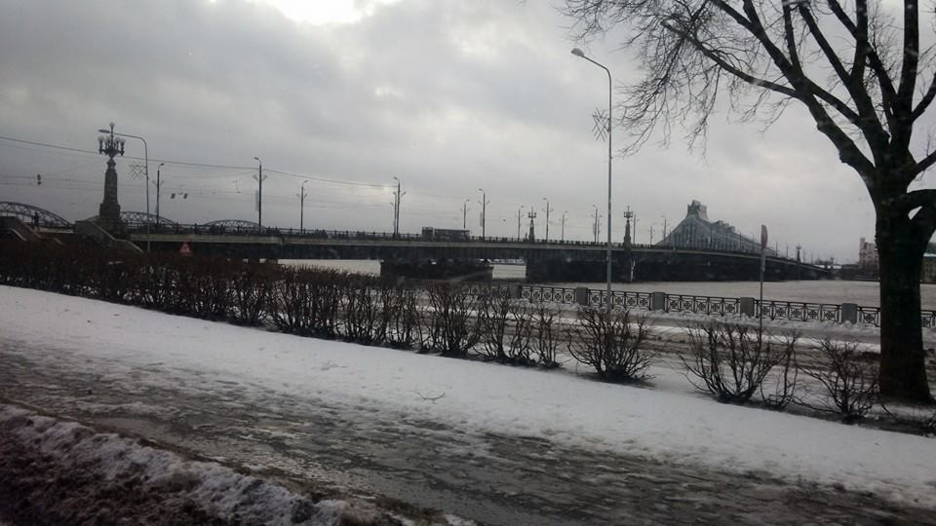
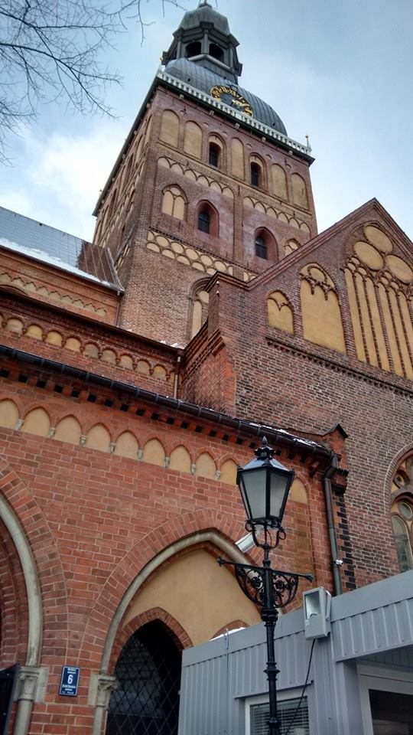
Why are we here?

Slide 4
We, Inclusiva NGO, salute the Latvian Government and its Presidency of the European Union for their bravery and wisdom, for making great political, scientific and technical efforts towards a world safer for all, including the forgotten ones; we, the people with disabilities.
We are here to learn and to contribute to make an inclusive safer world

Slide 5
Main Ideas
Disability is a cross-cutting issue of concern to all within disaster risk management.
Persons with disabilities are at disproportionate risk from disasters.
Persons with disabilities can, and should, actively contribute to, and meaningfully participate in, disaster risk management policy and practice.
Inclusive Standards, protocols and indicators of disability are needed.

Slide 6
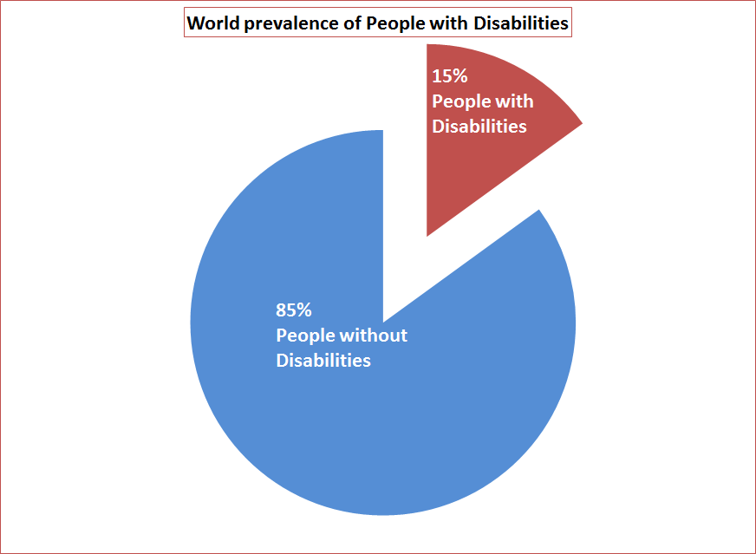
World prevalence of people with disabilities
People with disabilities global prevalence is - according to World Health Organization (WHO) World Report on Disabilities- 15%, one thousands million people live with any disability and 3% of them have severe functioning problems

Slide 7
Epistemic Background
The proposed epistemic framework came from the International Classification of Functioning, Disability and Health, known more commonly as ICF; it provides a standard language and framework for the description of health and health-related states. ICF is “a multipurpose classification intended for a wide range of uses in different sectors” (WHO, 2001).

Slide 8
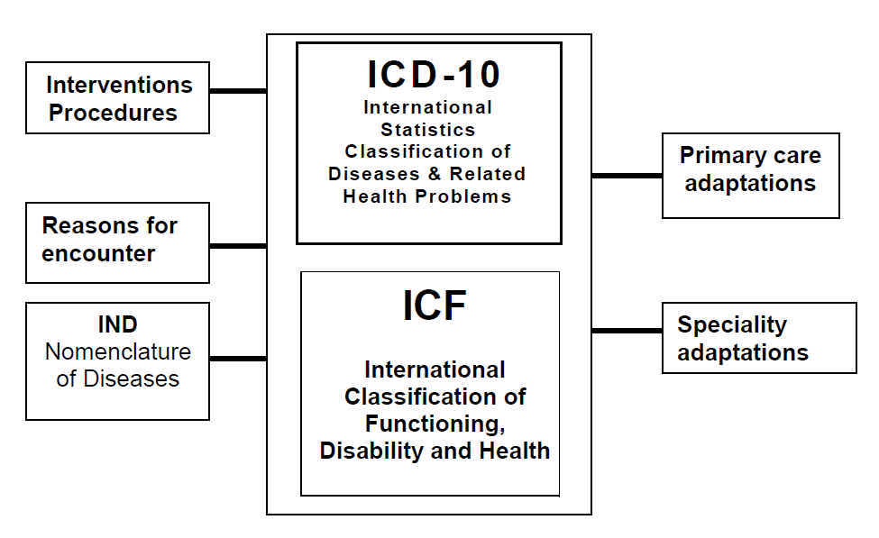
Adaptated to be used on Inclusive Emergency Management

Slide 9
The functioning of a person with disability will be negative affected when facing barriers, if this happens in an emergency survival opportunities will decrease and risk of injury will rise

Slide 10
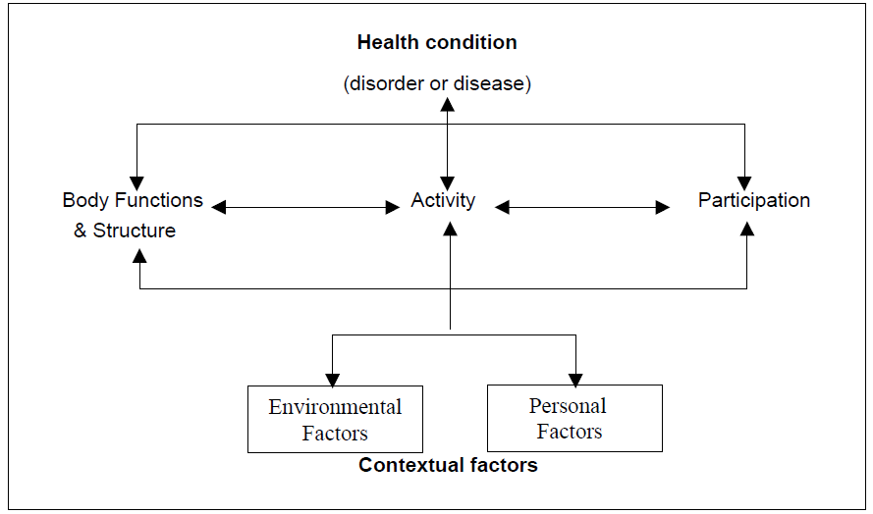

Slide 11
The following concepts have been in used in the project “Peñaflor Town Incluisive Safe Community: Resilience for all”, winner of Risk Award 2014

Slide 12
Needs of persons with disabilities throughout disaster management cycle
Are the needs of person with disabilities the same needs of the rest of the populaion, or are they one and the same?
Or

Slide 13
THE ANSWER IS…

Slide 14
BOTH

Slide 16
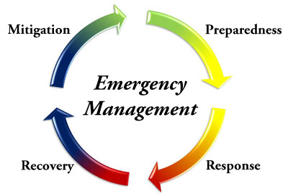
Adapted Common needs: this term refers to the needs that are common for both, people with disabilities and people without disabilities, but in order to satisfy the need for people with disabilities, the environment conditions have to be fitted to allow these needs to be met. Adapted Common Needs are present in the entire Emergency Management Cycle.

Slide 17
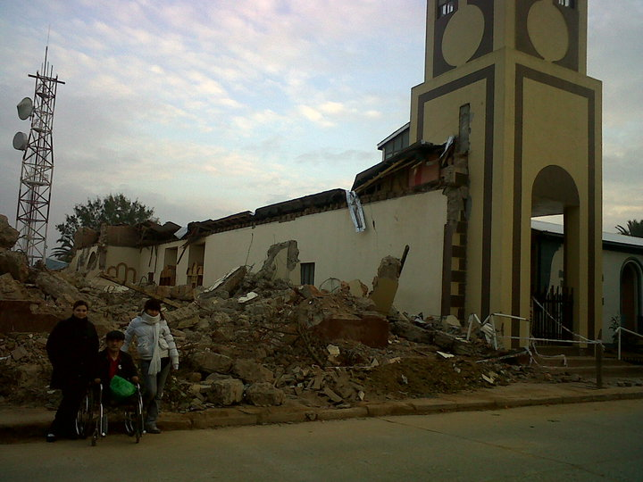
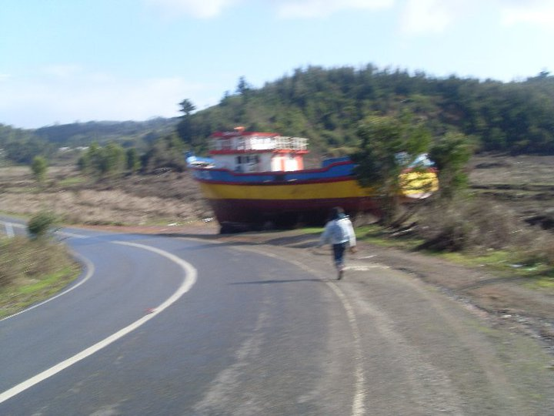

Slide 18
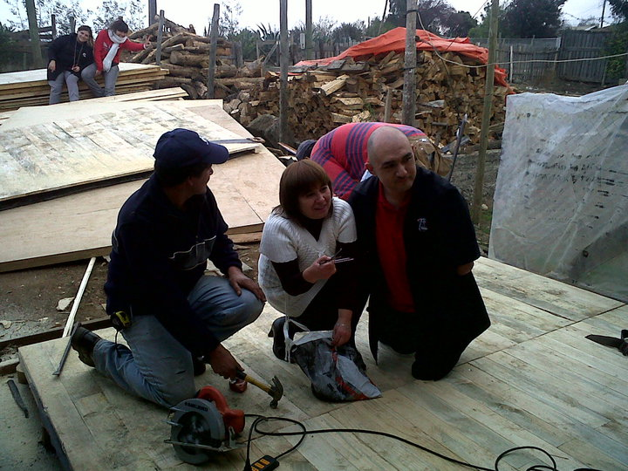
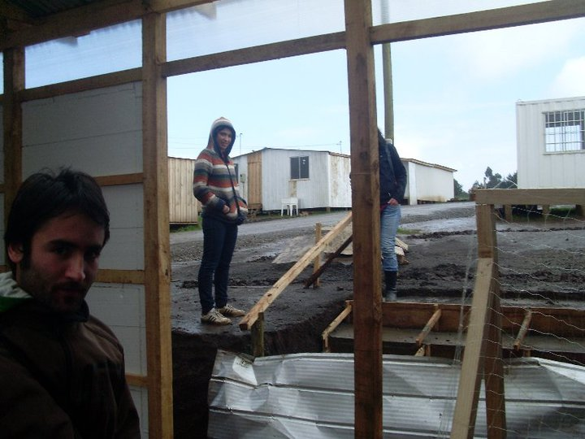
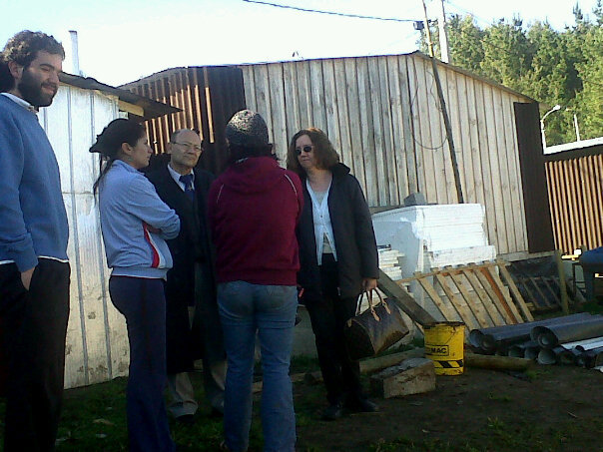
Example of Adapted Common Needs: Chile, 2010, after the 8.8° Richter Earthquake and Tsunami, Chilean Government implemented a programme called “aldeas” (village in Spanish) as you would see on the pictures. Emergency houses were made of light materials (wood) and were located in different parts of the affected territory. Water supply and toilets were located in high grounds.

Slide 19
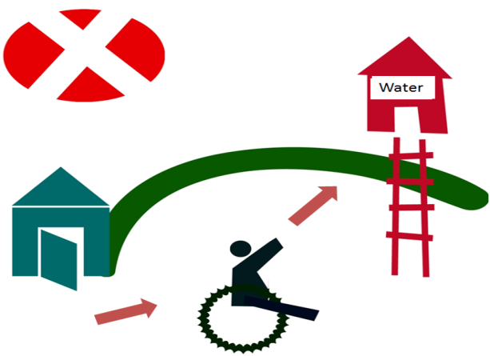
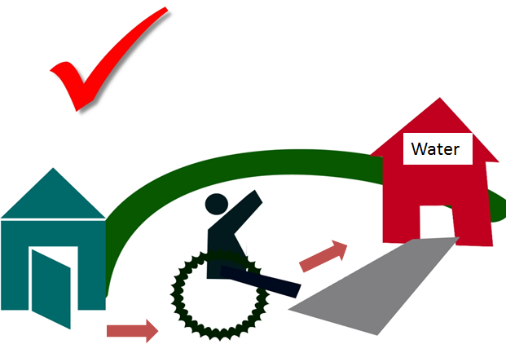
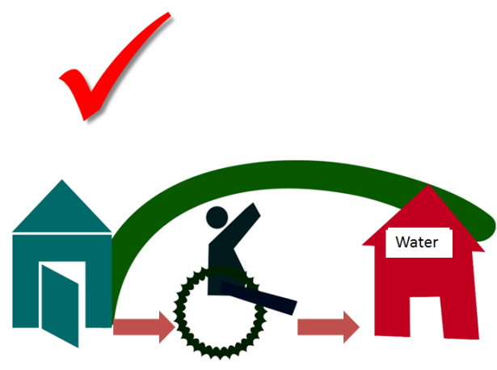
If water supply is in a high ground, people with disabilities, or elderly people, would be limited their access to water to the “good will” of other people
If its impossible to located water supply in a flat location, adaptation with accessibility is a very good policy
Universal Accessibility is the best practice to ensure everyone can have access to water

Slide 20
b) Exclusive needs: it refers to needs that belong only to people with disabilities such as the need of having Technical Aids (such as wheel chairs) . Exclusive Needs are an integral part of the Emergency Management Cycle

Slide 21
E.g. a person who is a wheelchair user and his/ her wheelchair is render useless due to damage produced by a disaster (earthquake, fire, or flood), would need to have his/ her wheelchair repaired/ replaced as soon as possible in order to have movement capacity.

Slide 22
INCLUSION STANDARDS AND INDICATORS APPLIED TO INCLUSIVE EMERGENCY MANAGEMENT

Slide 23
An Inclusion Standard of the Disability Variable applied to Emergency Management is a document that provides requirements, specifications, guidelines or characteristics that can be used consistently to ensure that materials, products, processes and services are fit for their purpose related to Emergency Management Cycle, ensuring full inclusion of people with disabilities, in every aspect of the above mentioned materials, products, processes and services

Slide 24
Inclusion Indicators of the Disability Variable applied to Emergency Management are tools that show if a material, product, and/ or a service meets the criteria described in the Inclusion Standard

Slide 25
Inclusion Standard of the Disability Variable applied to Emergency Management
Establish context
Communication and consultation
Monitoring
and
review
Risk assessment
Risk identification
Risk analysis
Risk evaluation
Risk treatment
Inclusion Indicators of the Disability Variable

Slide 26
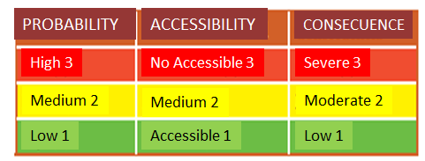
THREAT= CONSECUENCE X PROBABILITY X ACCESSIBILITY

Slide 27
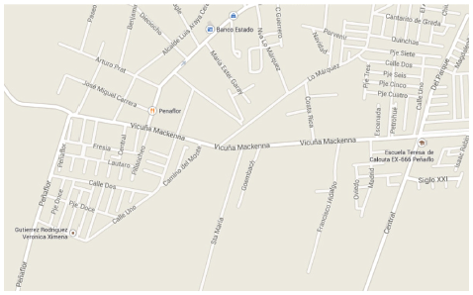
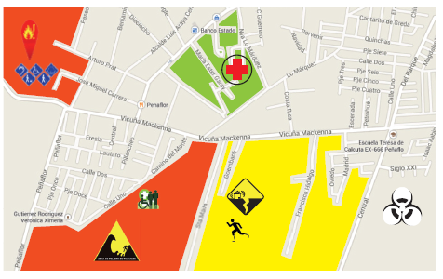
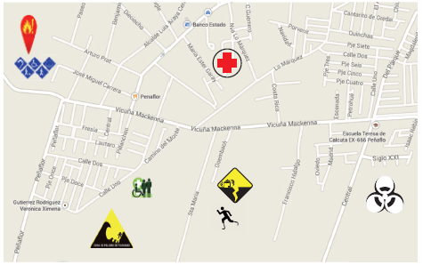
INCLUSIVE EMERGENCY MAP

Slide 28
Inclusion Indicators examples;
a) Total number of Emergency Management policies with participation of People with Disabilities in relation to Total number of Emergency Management policies”,
b) “Total number of Inclusive Safety Measurement in relation with Total number of Safety Measurement”,
c) “Total number of Emergency Response personnel trained in People with Disabilities Emergency Attention in relation to Total number of Emergency Response personnel”
d) "Total number of infrastructure rebuilt with universal accessibility in relation to total number of infrastructure rebuilt
e) Morbidity Rate of people with disabilities compared to general morbidity rate

Slide 29
LET’S GO FOR A SAFER, INCLUSIVE WORLD FOR ALL!!!!!!!!!!!!

