Slide 1
Smartphone based multi-channel emergency alerting
Jaana Kuula
University of Jyväskylä
Department Of Mathematical Information Technology
Finland
Email: jaana.kuula@jyu.fi
Latvian Presidency of the Council of the European Union
Workshop on Civil Protection:
Workshop on needs of persons with disability throughout disaster management cycle
12-13.1.2015 Riga, Latvia

Slide 2
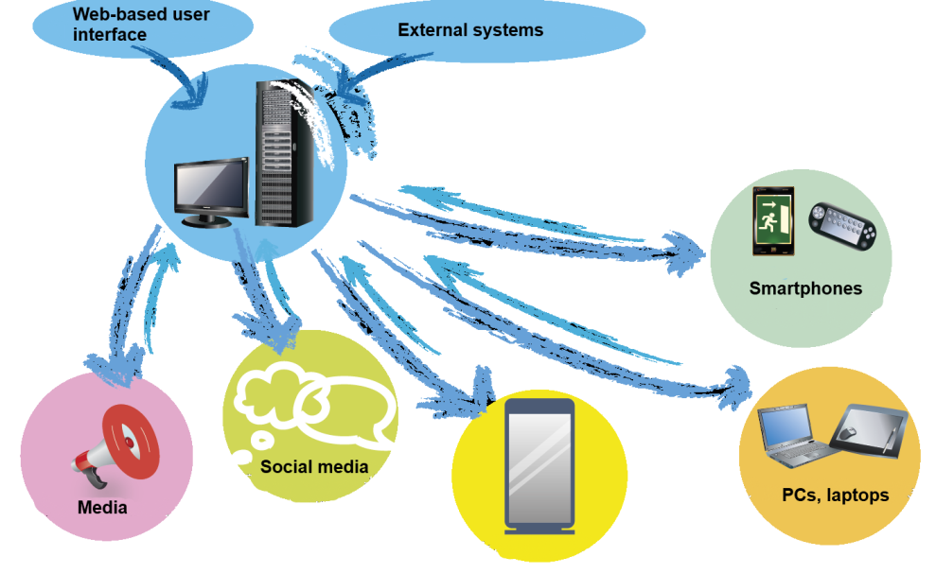
The operation of the smarphone-based multichannel emergency alerting system
Alerting for
- Auditory
- Visual
- Sensory
- Cognitive (textual)
senses with smartphones
+ Special devices may be added for better reception when needed
tablets
Electronic bulletin boards
The system was developed at the University of Jyväskylä with the support of the Finnish Funding Agency for Innovation – Tekes, European Structural Funds ERDF and private companies in Finland
Several practical tests were made with the preparedness group and counter-terrorism group of the Finnish Police, Fire and Rescue Department of Central Finland, City of Jyväskylä, 500 student’s Kilpinen School and private citizens in Finland
The system is commercially available by Magister Solutions Ltd

Slide 3
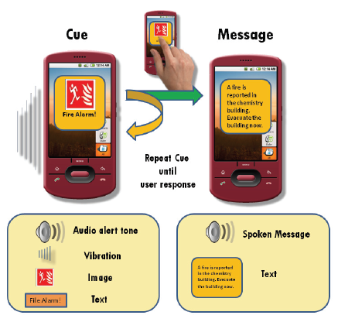
Alerting with four senses at the same time - alerts will be noticed with different senses and understood without local language or literacy
Alert will show up on the screen prioritized ahead of all other functions of the phone
Alerts will be received for 4 senses at the same time:
Auditory – hear
Visual – see
Sensory – feel
Cognitive – read
Additional information and rescue instructions are seen on the second screen
Rescue instructions can also be heard as a spoken message
An easily recognizable alerting tone will be played even if the phone is muted

Slide 4
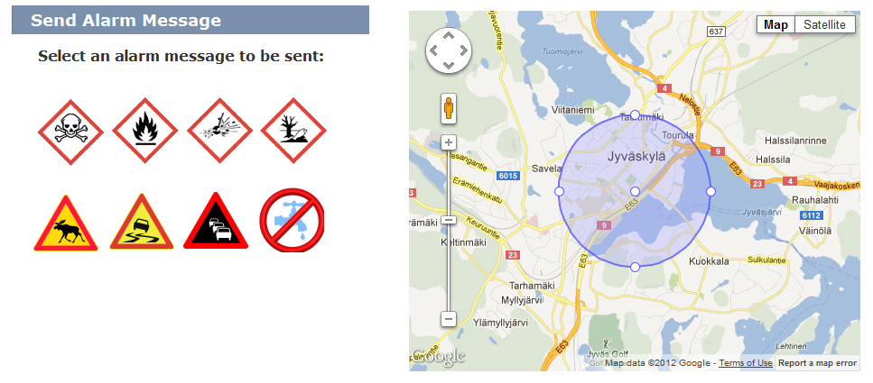
The alert zone may be defined geographically by need each time - Also profiled group alerts may be given for people with disability
Alerting icons for different emergencies may be expressed by aGlobally Harmonized Labelling Standard (GHS) or similar
Range of the alert / emergency area 0,1 - ∞ km

Slide 5
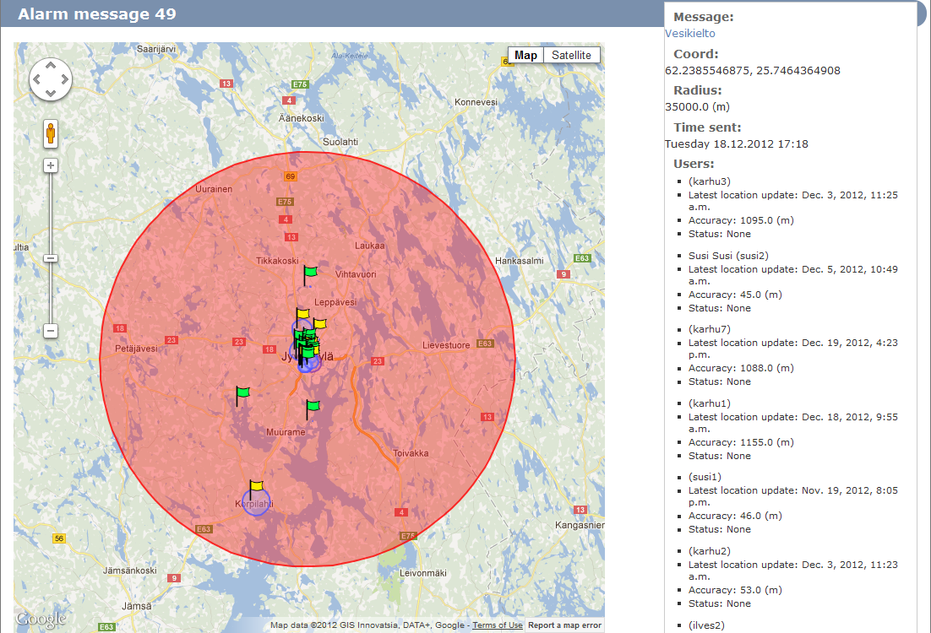
During the emergency the status and location of casualties is shown for the rescue services on the situation map – help will be sent accordingly
User is ok
User needs help
No contact has been received with the user

Slide 6
Impact
Alerts will be received with alternative senses at the same time: as a specialized alerting tone, visual icon, vibration signal and written text
Specialized peripherals can be added into the system for better reception
Profiled group alerts can be given for various groups (eg. for people with special needs and different languages)
Only those people or their care takers who are in danger will receive alerts
Only true and confirmed information will be delivered by rescue authorities; no rumors, unconfimed or non-authorized information in the system
Rescue authorities will know whether you need help and where you are, help will be sent accordingly
Life threatening alerts can be separated from less urgent information
Faster and more advanced technology than SMS
Widely spread common technologies and all kinds of handsets and peripherals can be used with the system, no extra costs for users
Cheap, efficient and flexible system for authorities, no costs for SMS when alerts are sent on another than telephone line (free of charge in Finland)
No investments are needed on mobile phone base stations or other telecommunication infastructures (e.g. no cell broadcasting investments are needed)

Slide 7
Recommendations
Alerting tones for mobile alerting systems should be harmonized within the European Union.
The usage of mobile emergency alerting tones for other than emergency usage should be forbidden.
Internationally harmonized and easily understandable alerting icons and labels should be taken in use for most common emergencies, e.g. similarly as the global GHS classification and labelling of dangerous chemicals.
An easily by touch understandable and from language and disabilities independent international emergency alerting code should be created on the vibration features of smartphones.
Mobile phone base stations should be secured better in case of electricity cutdowns and cyber attacks.
Citizens should be better prepared for crisis communication in case of electricity cutdowns and denial-of-service attacks, e.g. have extra batteries for their mobile communication media.
Mobile devices should be secured against cyber attacks and hijacks.
Rescue services should modify their operating procedures for taking in use interactive mobile emergency alerts.
Societies should have better alerting systems around critical infrastructures and other possible targets of severe accidents and malicious attacks.
Thank you!

