Slide 2
............
…
….
…
…
…
…

Slide 3
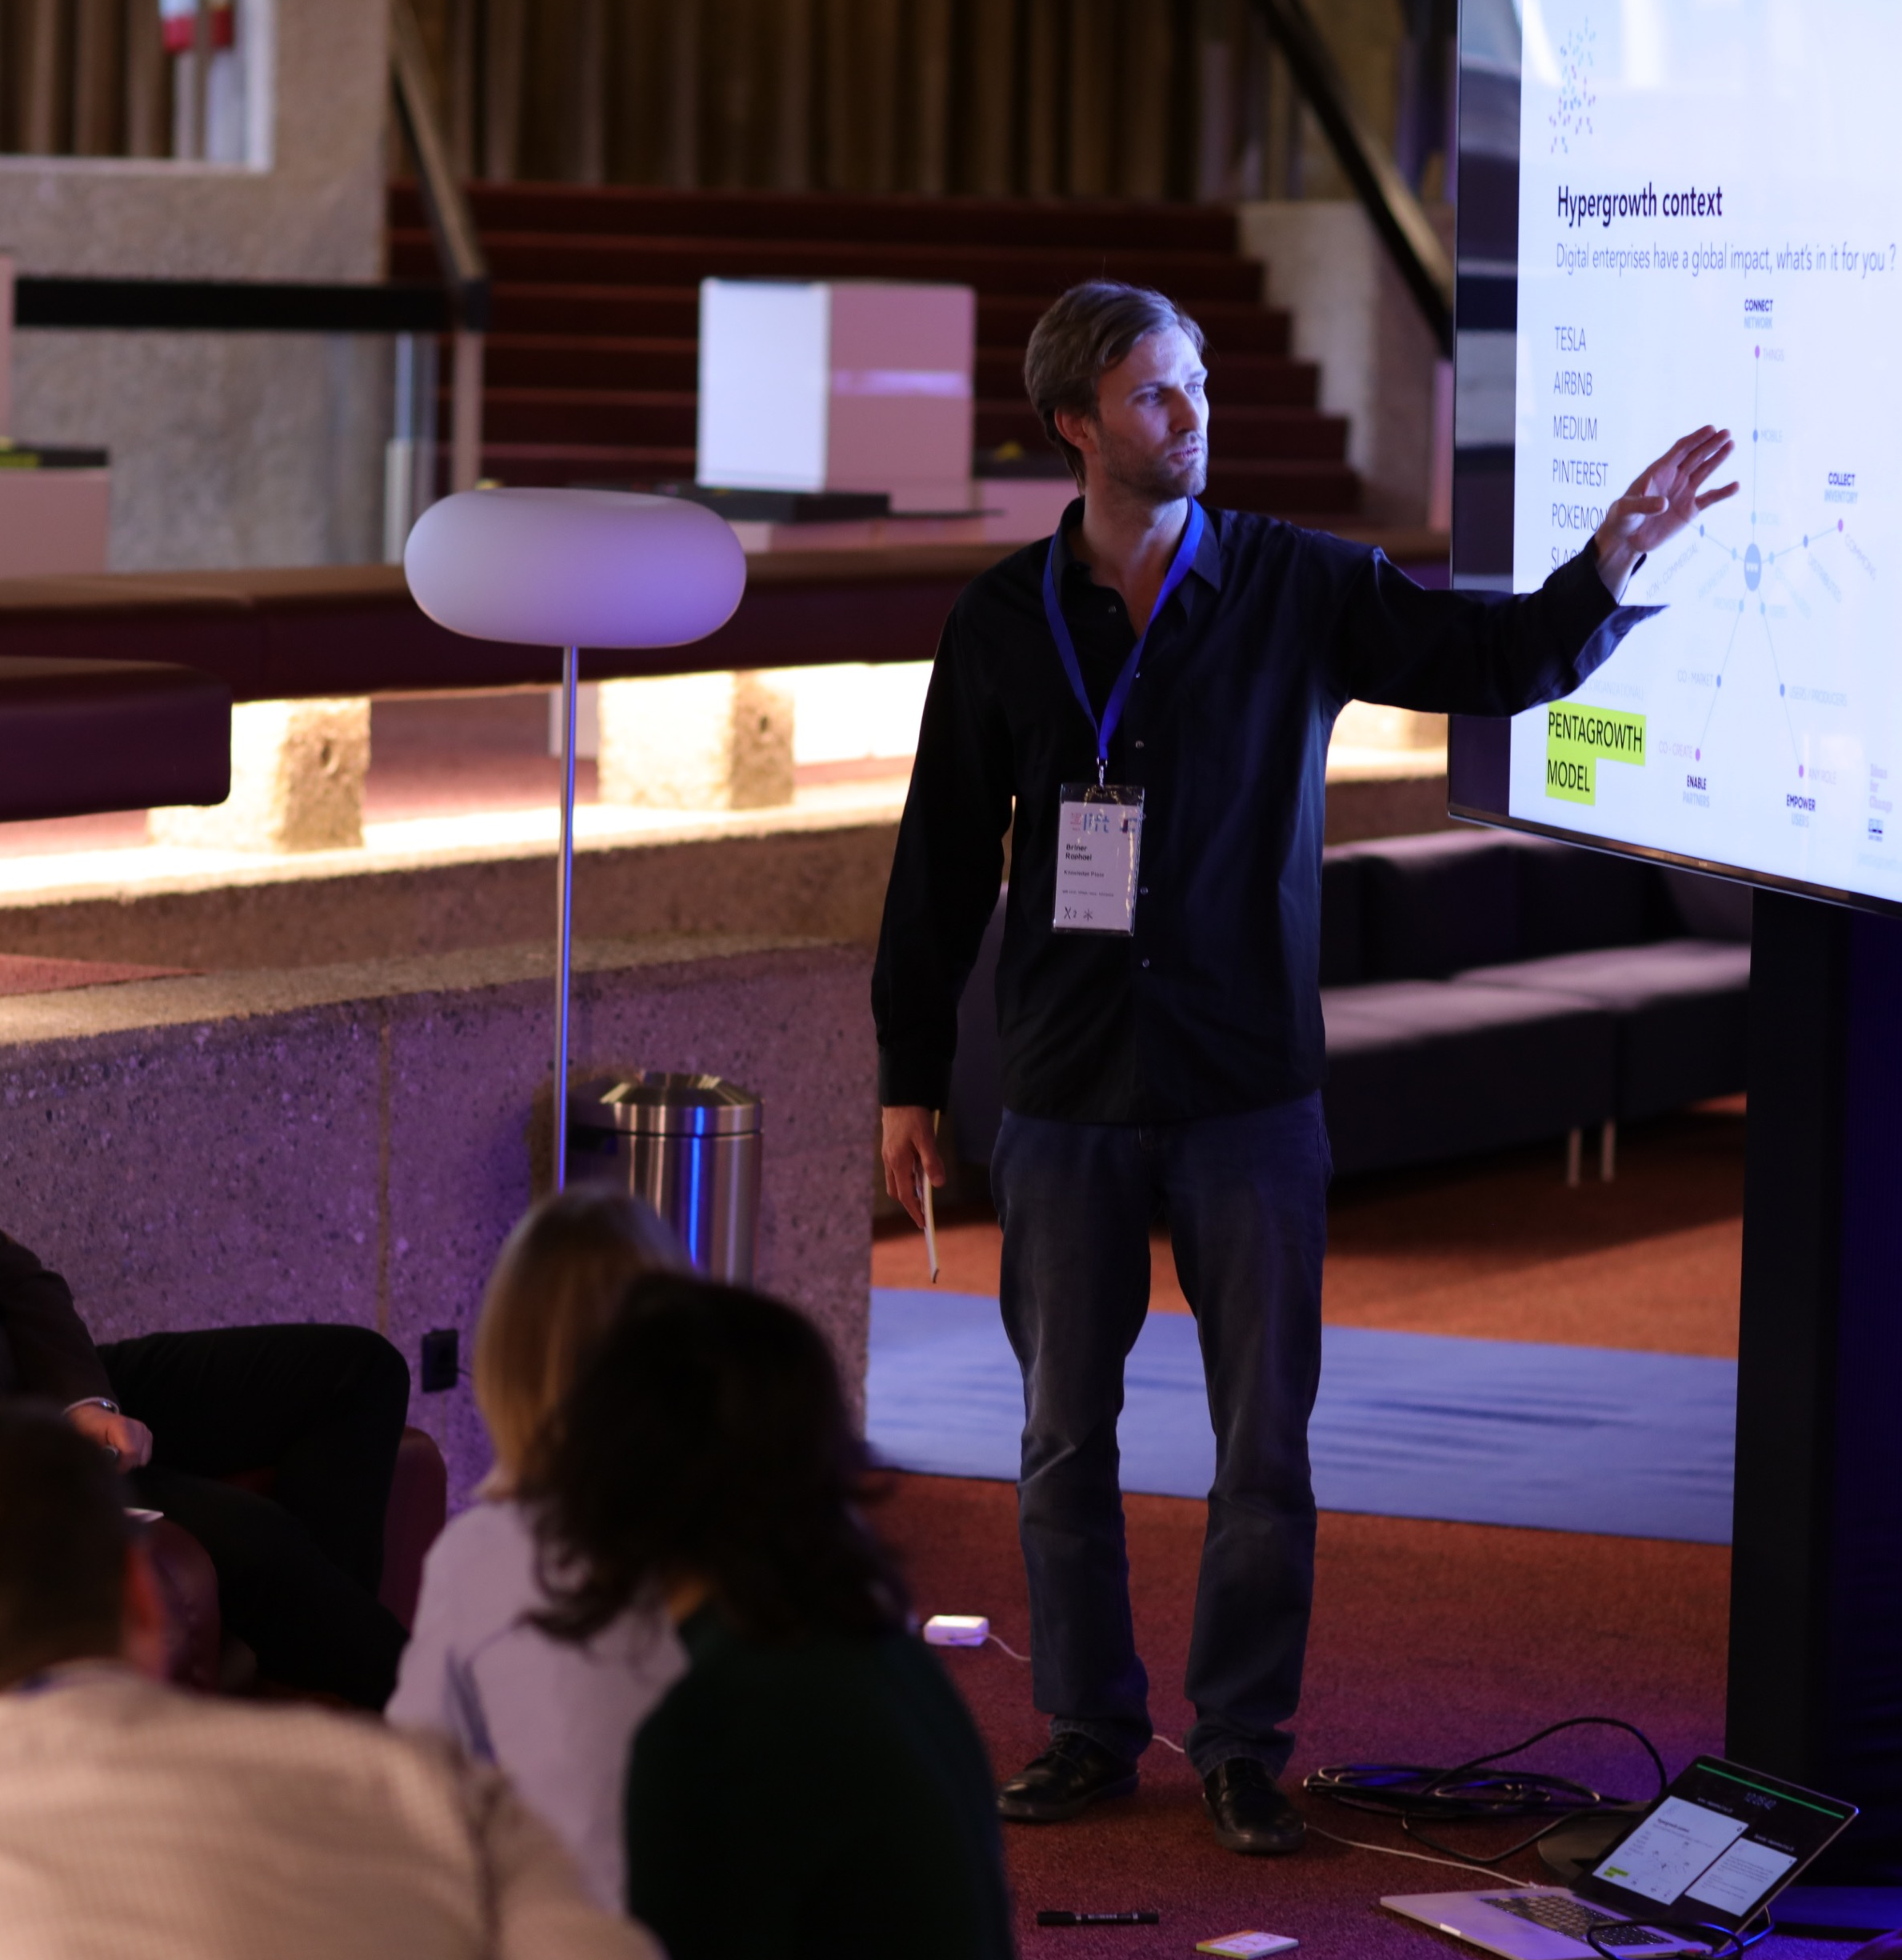
Platform on Disaster Risk Reduction
9-13 October 2018 Tunis, Tunisia

Slide 4
This is an exemple of a quote this is an exemple of a quote.
Alexandre Jones

Slide 5
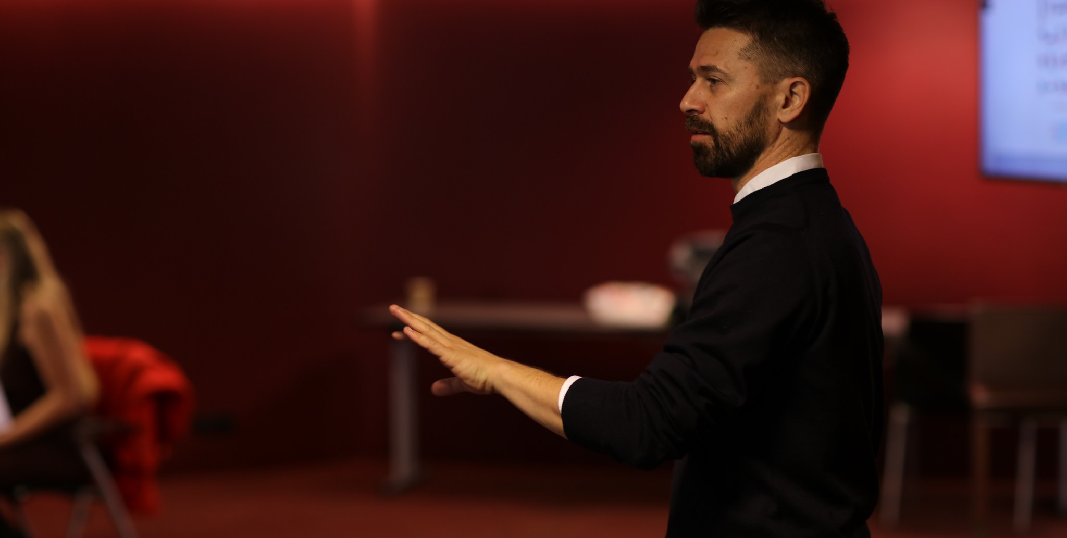
This is an exemple of a quote this is an exemple of a quote.
Alexandre Jones
Platform on Disaster Risk Reduction
9-13 October 2018 Tunis, Tunisia

Slide 6
TITLE
……………………………….

Slide 7
TITLE
…………………...
Platform for Disaster Risk Reduction
9-13 October 2018 Tunis, Tunisia

Slide 8
Platform on Disaster Risk Reduction
9-13 October 2018 Tunis, Tunisia

Slide 9
……..

Slide 10
Thank you

