Slide 1
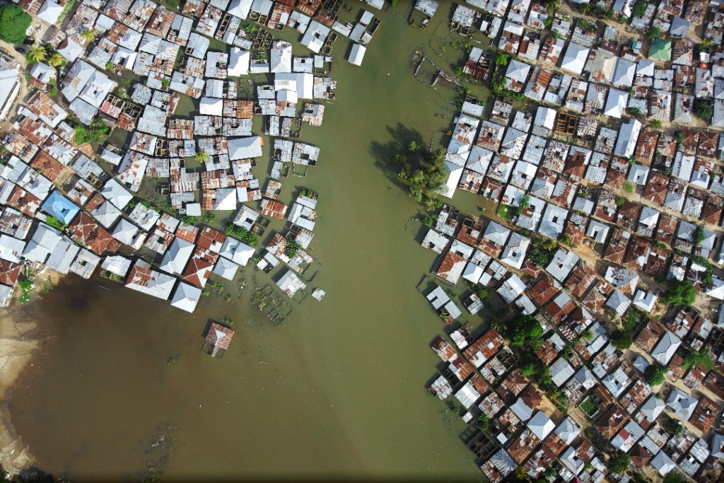
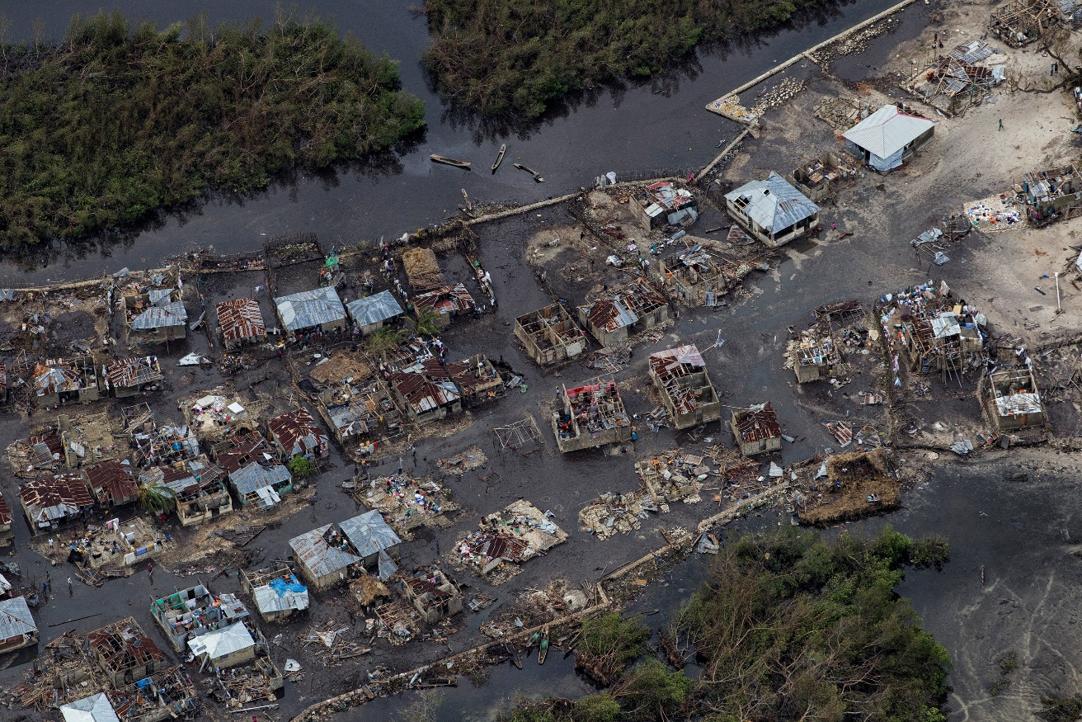
Socioeconomic Aspects of Disaster Risk Reduction
Daniel Kull
World Bank Group
dkull@worldbank.org

Slide 2
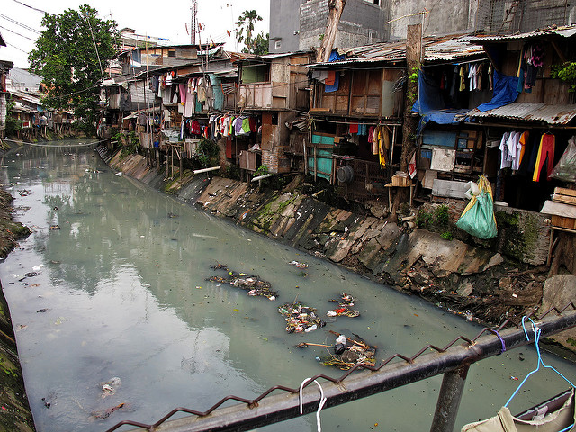
Disaster risk reduction is poverty reduction…
…and poverty reduction is disaster risk reduction
If natural disasters could be prevented next year,
26 million people would escape poverty.

Slide 3
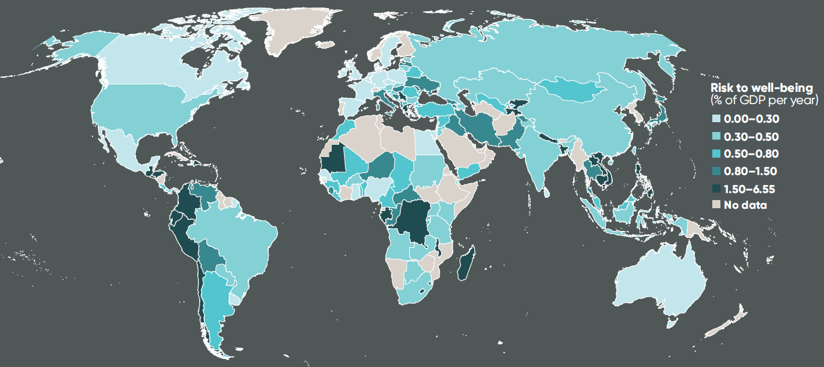
Natural disasters affect well-being
more than traditionally estimated
Annual asset losses:
> $300 million
Annual losses including to
well-being:
> $500 billion

Slide 4
Policies that make people more resilient
can save $100 billion per year
Policy Action | Avoided Global Asset Losses | Avoided Global Well-Being Losses
Reduce exposure of the poor | $7 billion | $40 billion
Reduce exposure of the non-poor | $19 billion | $22 billion
Reduce vulnerability of poor people’s assets | $2 billion | $14 billion
Reduce vulnerability of non-poor people’s assets | $6 billion | $7 billion
Provide universal access to early warning systems | $13 billion | $22 billion

Slide 5
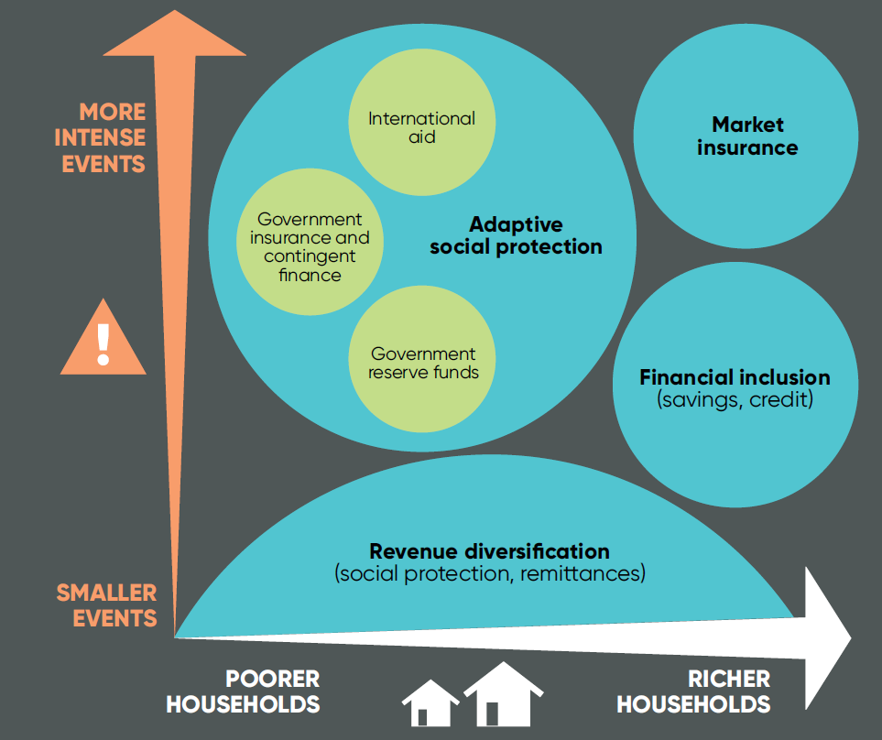
Increasing resilience is good economics…
…but it requires flexible
and holistic
risk management
that uses
different tools for
different types of
disasters and
populations

Slide 6
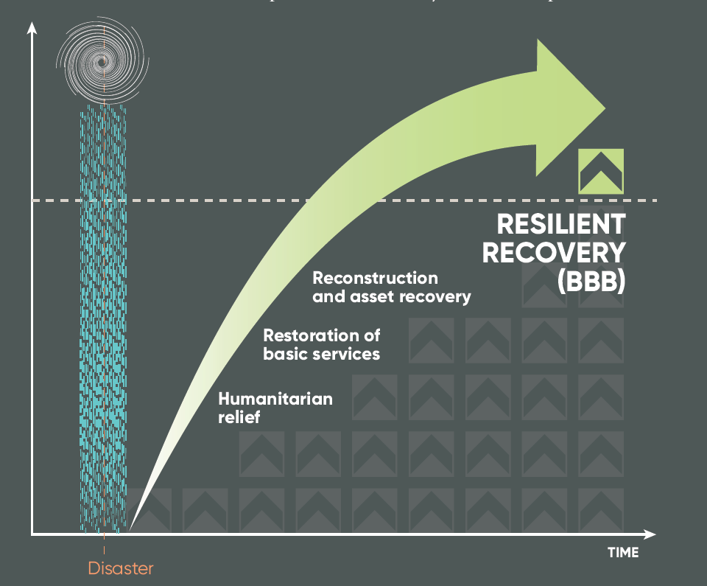
Building Back Better…
…Stronger, Faster, & More Inclusively
Global well-being losses
can be reduced by over 30%
Equivalent to a
$173 billion annual gain

Slide 7
The ability to build back better…
…depends on thorough preparation
More inclusively
Social protection programs targeting the most vulnerable
Ensuring reconstruction does not overlook low-income areas
Focus on avoiding the impact on children and disadvantaged groups
Stronger
Risk-informed building codes
Smart spatial planning
Pre-approved designs
Technical assistance

Slide 8
The ability to build back better…
…depends on thorough preparation
Faster
Pre-listing and pre-contracting firms for debris removal and reconstruction
Prioritizing reconstruction needs, starting with basic needs
Contingent financing for government
Access to insurance and borrowing for firms and households
Rapidly scalable social protection systems
Streamlined allocation of recovery funds

