Slide 1
International Day for Disaster Risk Reduction 2018
MIKTA-UNISDR seminar
19 October 2018
Strengthening DRM through international cooperation
Cyrille Honoré

Slide 2
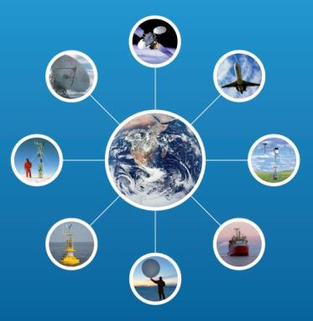
WMO Integrated Global Observing System (WIGOS)
Coordinated observation of the globe with agreed standards
Notes:
Basically, decades ago, meteorologists felt the need to organize themselves in order to produce, share and store comparable data, using harmonized procedures and methods

Slide 3
WMO Information System (WIS)
Sharing global data in standard format

Slide 4
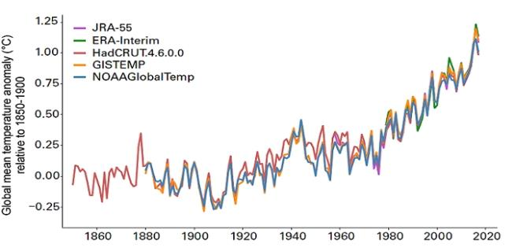
Global mean temperature rising
Global mean temperature already exceeded 1 degree Celsius above pre-industrial level

Slide 5
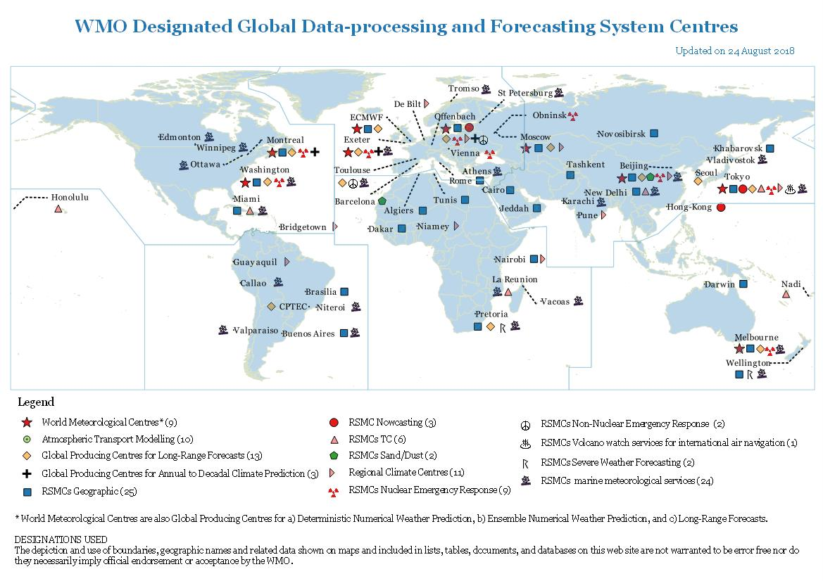
Global Data-Processing and Forecasting System
Making available weather and climate analyses and forecasts
Notes:
Seoul, Korea is a global producing centre for long range forecasts
Melbourne, Australia, is a World Meteorological Center , geographic and tropical Cyclone, marine and nuclear emergency response center.

Slide 6
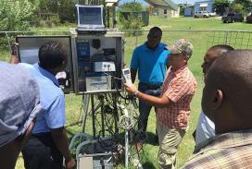
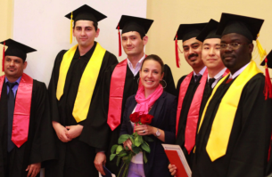
Capacity building for developing countries
Education and Training Programme in place to connect people and institutions in need to the learning opportunities
regional training centres offering targeted training courses
provision of opportunity for fellowship
WMO Global Campus online resources

Slide 7
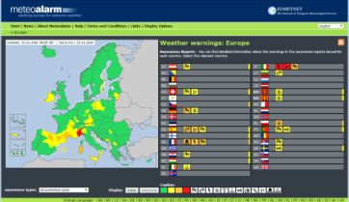
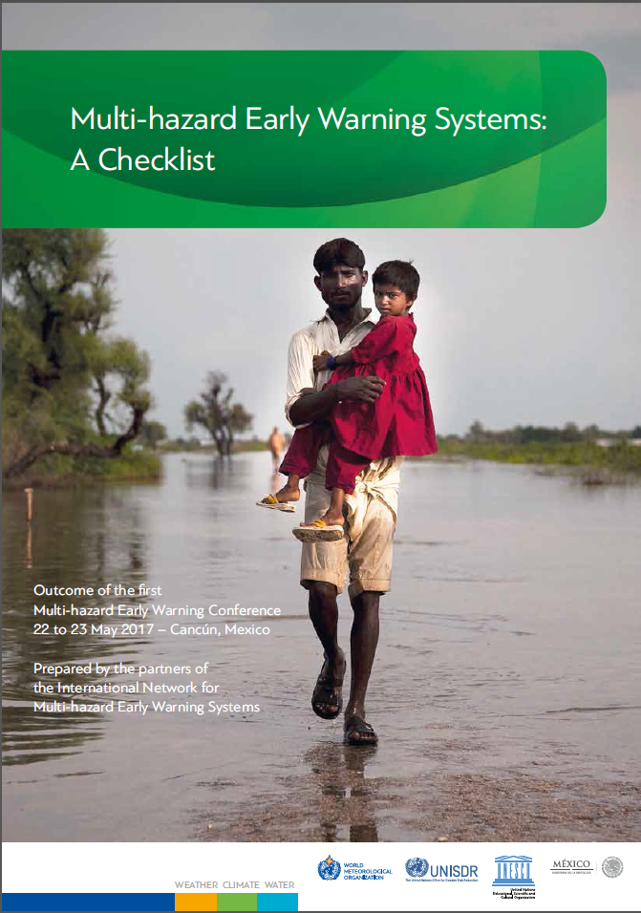
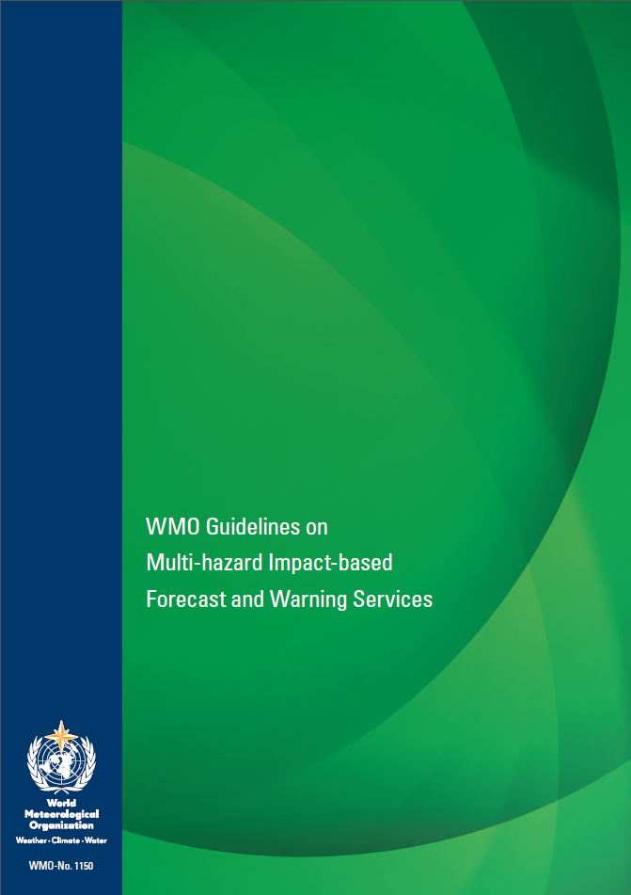
Authoritative multi-hazard early warnings
Cooperation is also crucially needed with relevant stakeholders outside the WMO community, at all global, regional, national and local levels
Fostering a community of practice through tools, guidelines, training workshops and building on the

Slide 8
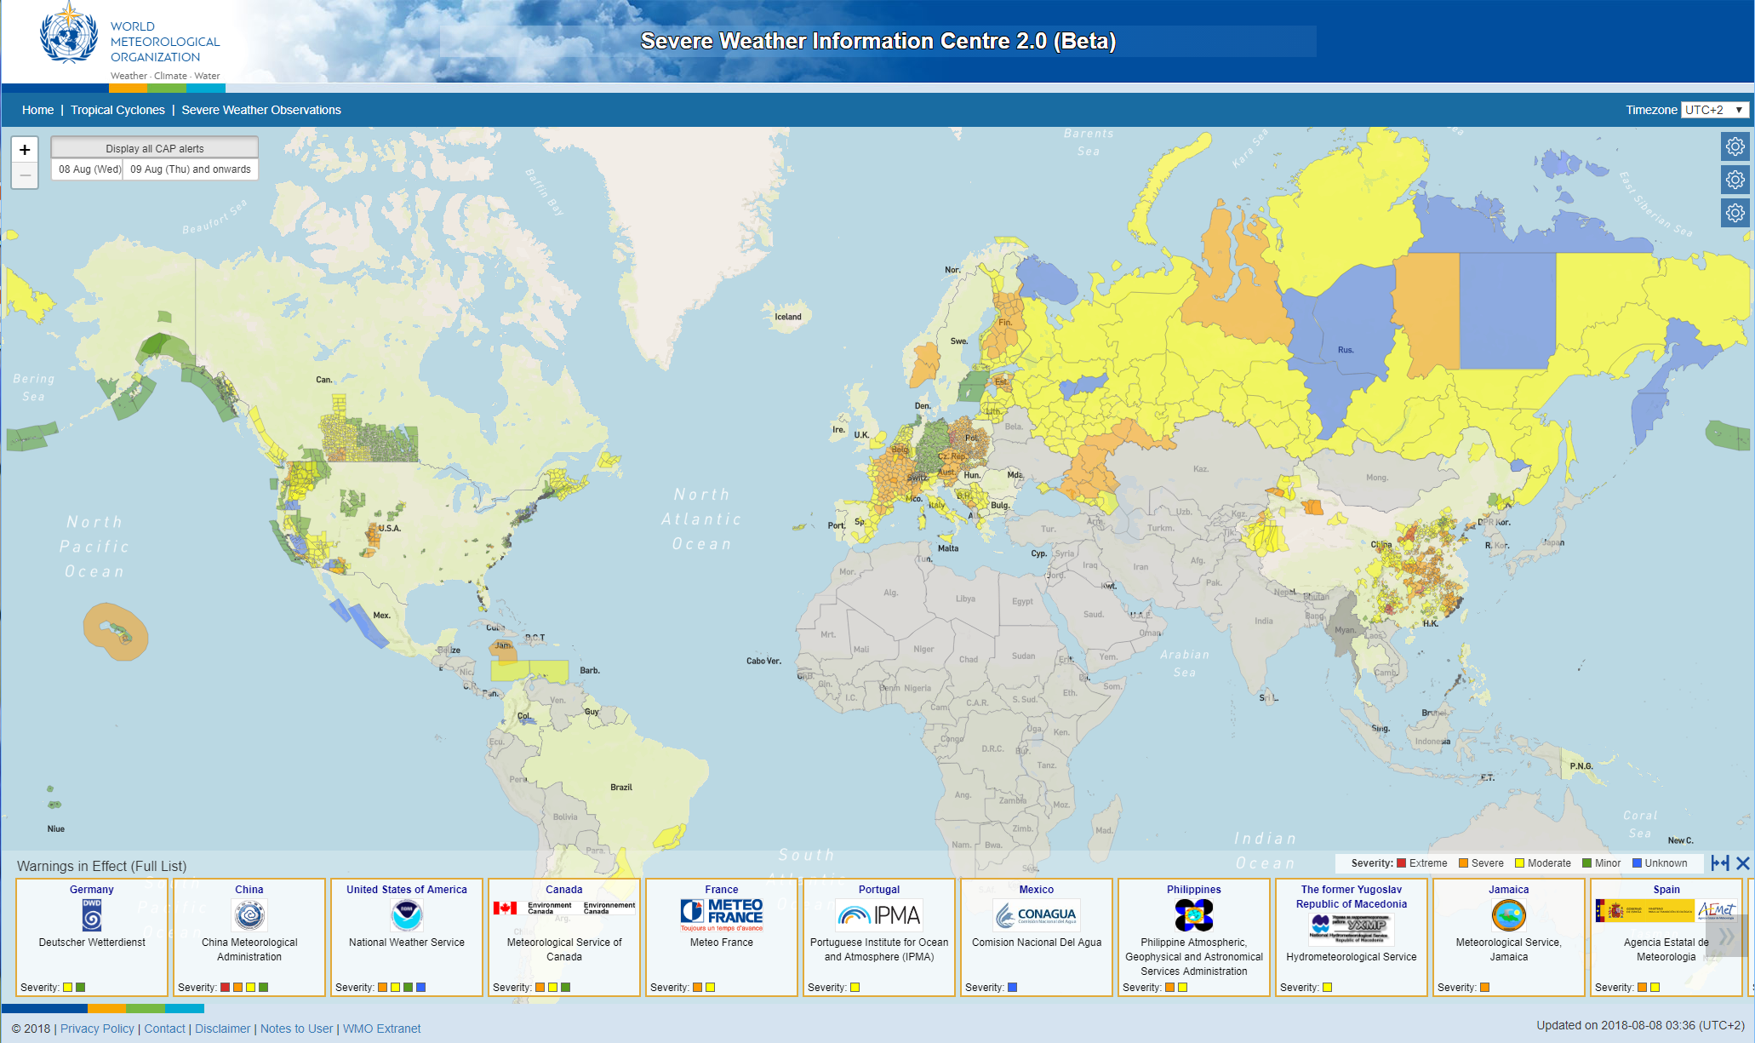
Global Multi-hazard Alert System (GMAS)
Severe Weather Information Centre (SWIC) and World Weather Information System (WWIS) being revamped to form the initial core component of GMAS

Slide 9
CREWS Caribbean EWS Initiative – a case for International Cooperation with SIDS
2017 Hurricane Season
Hyperactive season provided an opportunity to conduct the first ever comprehensive post-disaster review of MHEWS. Billions (USD) in losses, & damages, economic gains stymied, > 300 deaths, 1,000s displaced,
Evidence generated from review of EWS in the Caribbean incorporated into the bigger CREWS initiative
Regional initiative focuses on:
Strengthened governance via a regional strategy, closing the critical capacity gaps regionally & nationally & better alignment of gender considerations
Collaboration between International, Regional, National entities and experts
NMHSs, NDMOs & Gender Bureaus
Global – WMO, WB, UNISDR
Regional – CDEMA, CIMH, Gender expert
Expert institutions & personnel (KNMI, ITU)
Notes:
Information to the left is from the Caribbean Lessons Learnt on EWS following the 2017 Hurricane season. A review process that was led by WMO and supported by WB, UNISDR & the CREWS Secretariat. Info to the right is the link between evidence from the review incorporated into the bigger regional initiative soon to start
The environment provided an opportunity to conduct a review shaped around international and regional cooperation along with critical stakeholders at the national level inclusive of Gender experts & practitioners. This was the first time such an extensive review has taken place (using the WMO launched MHEWS checklist as the basis for evaluation & validation of priority areas for investment).
Evidence generated from the review of the EWS were fed into the Regional Initiative for the Caribbean which is scheduled to start soon (next month if I am not mistaken)
This collaboration brings together the comparative advantages of partners internationally and regionally strengthening engagement between experts, institutions and vulnerable communities (for the latter it is understood that when engaging national institutions in the Caribbean you are very likely interacting with persons living in vulnerable locations given the size of the respective island states). It also provides a great opportunity to develop a model that can be used in other SIDS regions when wanting to streamline EWS investments within an overall Sustainable Development framework.

Slide 10
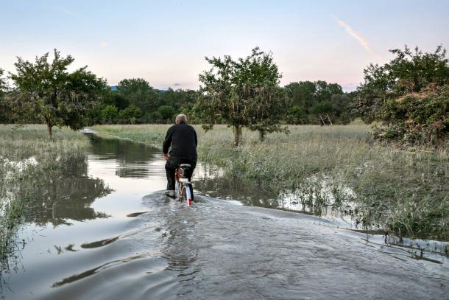
Climate-smart
Reliable climate information to support climate change adaptation and resilience
Weather-ready
Impact-based multi-hazard early warnings
Water-wise
Early warning information for coastal inundations, floods and drought

Slide 11
Thank you

Slide 12
….a specialized climate risk and early warning initiative that saves lives and livelihoods in least developed countries and small island developing States.

Slide 13
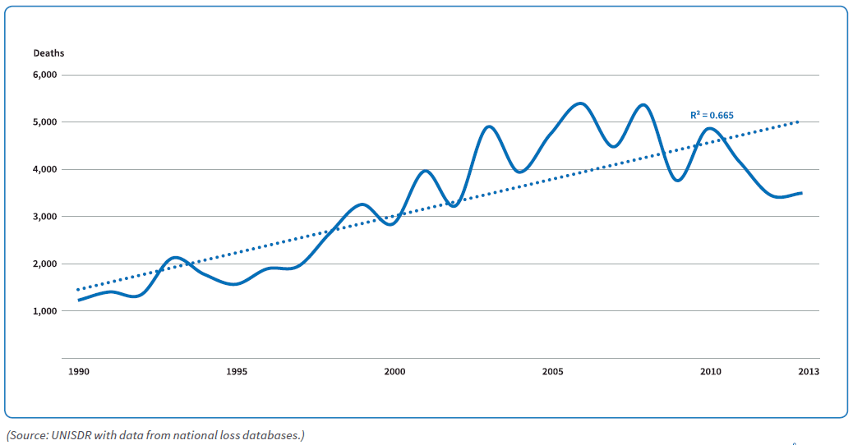
WMO Strategic Plan 2020-2023 sets an ambitious Goal – to close the capacity gap on weather, climate, and water services between developed and developing countries
Casualty risk increasing in LDCs and SIDS (going down in most other countries)
Extensive mortality 1990-2013

