Slide 1
Global Platform For Disaster Risk Reduction
8- 13 May 2011
Geneva, Switzerland
Lebanon’s National Risk Assessment
Nathalie Zaarour

Slide 2
Content
Lebanon risk profile
Risk Identification Program in Lebanon
Challenges
Lessons and Good Practices
Agencies Support and expectations

Slide 3
Natural & Man Made Disasters in Lebanon
Earthquakes
Floods, Landslides
Forest fires
Tsunami
Climate Change
Snow storms
Fires
Droughts, Desertification
Epidemics
Environmental Disasters
Industrial Disasters
Aircrafts and maritime disasters
Wars

Slide 4
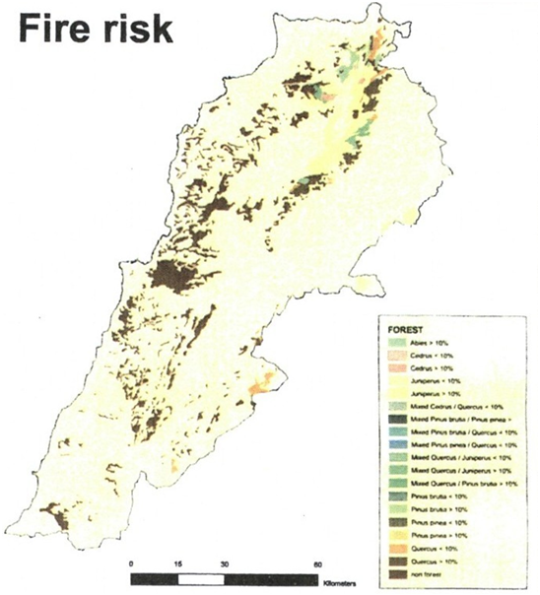
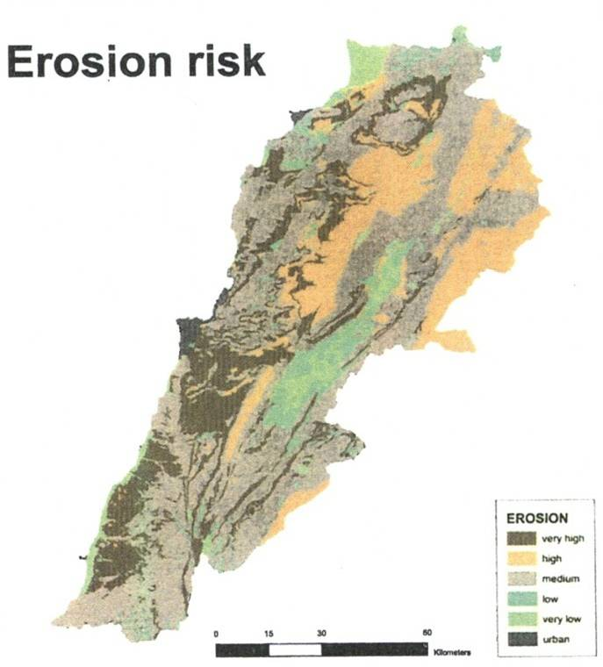
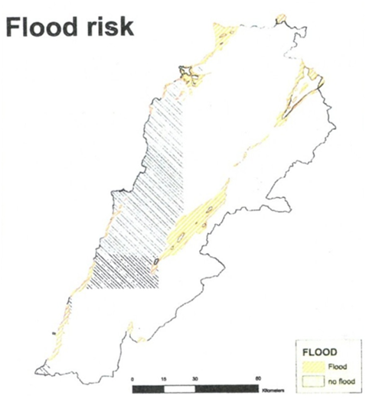
Overview of Key Disaster Risks

Slide 5
Key Findings Needs Assessment Disaster Risk Management
Most resources are directed at relief, rehabilitation and reconstruction efforts and not enough at prevention and disaster risk reduction.
Plans currently focus on response and do not sufficiently address prevention.
At the same time, the country does not have a national disaster management plan in place yet.
There is currently no authority actively working towards developing disaster risk reduction initiatives.
There is a lack in qualified staff at all levels to develop, implement and review policies integrating prevention and mitigation measures for disasters.

Slide 6
Risk Identification Program in Lebanon
Country Situation Analysis (CSA) objectives:
To review existing risk assessment studies and projects, publications and reports on risk assessment
To review data and data sources, organizations and institutions related to risk assessment
To review key professional risk-assessment related expertise, skills and experience available in Lebanon
To identify needs, gaps, and required support

Slide 7
CSA Methodology
GRIP methodology is thorough and rigorous, focused on seven areas, and is based on the notion that the risk assessment (RA) is an ongoing process
CSA is the first step of RA; because of time constraints and other challenges it is limited in its scope
A combined methodology was used, adopting as much as possible of the GRIP methodology and taking into account above challenges
As the visibility of DRM/R national projects within the country improves, and the CSA stages continue, it is envisaged that the process of the integration of the data will become easier going both ways

Slide 8
Implementation Activities
Interview with more than thirty stakeholders from various agencies including public sector (Ministries of agriculture, water, environment, urban planning, civil aviation, industrial research centre, LARI, Lebanese Army, Civil Defense, CDR, Civil Aviation, Beirut Port, CDR, LIBNOR, Urban Planning) , local NGOs (AFDC, Red Cross), foreign NGOs (Italian corporation, SDC, WHO) and universities and research institutes (CNRS, AUB, USJ)
Integration of studies and literature review
Analysis of interview results and studies
Report writing

Slide 9
Challenges in Implementation
Need for strengthening mechanisms for information exchange (to facilitate provision of risk assessment studies and risk reports)
Limitation of risk assessment studies which were eventually integrated and reviewed
Different level understanding of key terms within the Disaster Risk Reduction terminology (e.g. Risk Assessment)

Slide 10
Lessons and good practices
Engagement of the Lebanese Government in DRR at the Highest level
Coordination within all ministries , public administrations and private sector
Progress report on HFA for the first time
National Response Plan
Communication Strategy on DRR
Training Strategy on DRR
National Risk profile in process

Slide 11
Future Steps
Continuing implementation of CSA inventory with the engagement of stakeholders
Development of e-library
Evaluation of quality of data and information
Fill identified gaps in data
Propose linkages mechanisms
Strengthen capacity building efforts

Slide 12
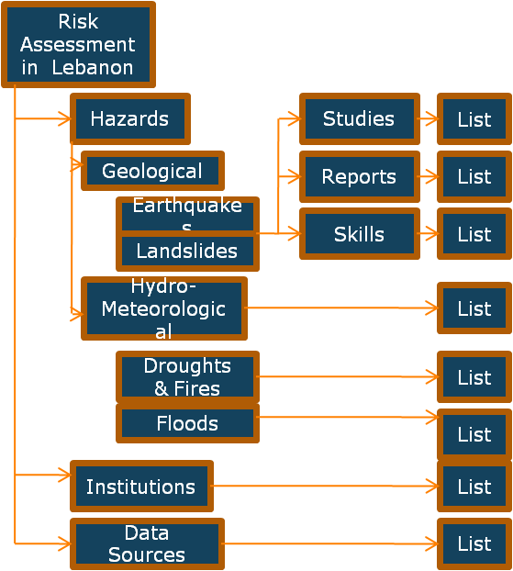
Future Steps
E-Library
A functional platform for information about DRA
Providing information, including metadata and location of data:
DRA-professionals
Risk assessment projects/ studies
Reports and publications on risk assessment, etc.
Establishment of the E-library: a continuous task
Proposed E- Library Concept

Slide 13
Agencies Support and Expectations
Government Institutions, UN Agencies, Donors
National Risk Assessment is supposed to be finalized end of 2011 by :
Developing and implementing the E- Library
Developing and implementing the DesInventar
Assessment of Critical Infrastructure
National Strategies of main hazards

Slide 14
Thank You !!!!

