Slide 1
Reducing Disaster Risk of Environmental Emergencies
4th Global Platform on Disaster Risk Reduction – Geneva – 23rd May 2013
Side event sponsored by:
Partners:

Slide 2
Reducing Disaster Risk of Environmental Emergencies
Moderator:
Dr Walter J. Ammann, President/CEO of the Global Risk Forum GRF Davos
Speakers:
Dr Urs Bloesch, Swiss Agency for Development and Cooperation (SDC)
(Head of Expert Group, Environment & Disaster Risk Reduction)
---
Ms Johanna Suikkanen, UNEP - Division of Technology Industry and Economics (DTIE),
(Associate Programme Officer)
---
Dr Daniele Ehrlich, Joint Research Centre of the European Commission
(Senior Researcher)
---
Mr Chris Dijkens, UN Economic Commission for Europe (UNECE)
(Chair of the Conference of the Parties to the Convention on the Transboundary Effects of Industrial Accidents)

Slide 3
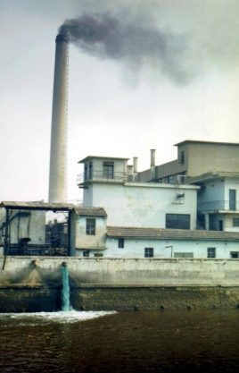
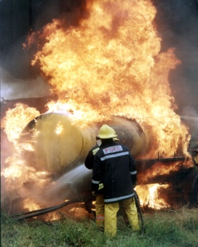
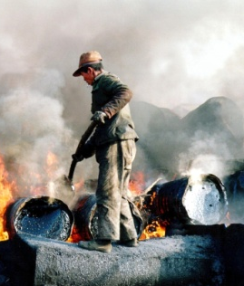
Reducing Disaster Risk of Environmental Emergencies
Major recent accidents:
Bhopal chemical disaster, India, 1984
Schweizerhalle chemical spill, Switzerland, 1986
Marinduque mining waste disaster, Philippines, 1996
Donana mining waste disaster, Spain, 1998
Izmit refinery damage and fire, Turkey, 1999
Baia Mare toxic waste spill, Romania, 2000
Toulouse AZF fertiliser factory explosion, France, 2001
Jilin petrochemical plant explosion and toxic spill, China, 2005
Ajka alumina sludge spill, Hungary, 2010
Mukuru-Sinai slum fuel pipeline explosion and fire, Kenya, 2011
Gumi chemical accident at Hube Global plant,
Republic of Korea, 2012
Waco fertilizer plant accident, USA, 2013

Slide 4
Reducing Disaster Risk of Environmental Emergencies
THANK YOU !

